Slide 1
Prepoznavanje nonograma i njihovo rešavanje
Srđan Milaković
Soft Computing 2015
Fakultet tehničkih nauka

Slide 2
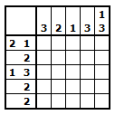
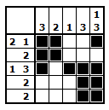
Šta je nonogram?
Nonograms, also known as Japanese crosswords, are picture logic puzzles in which cells in a grid must be colored or left blank according to numbers at the side of the grid to reveal a hidden picture.

Slide 3
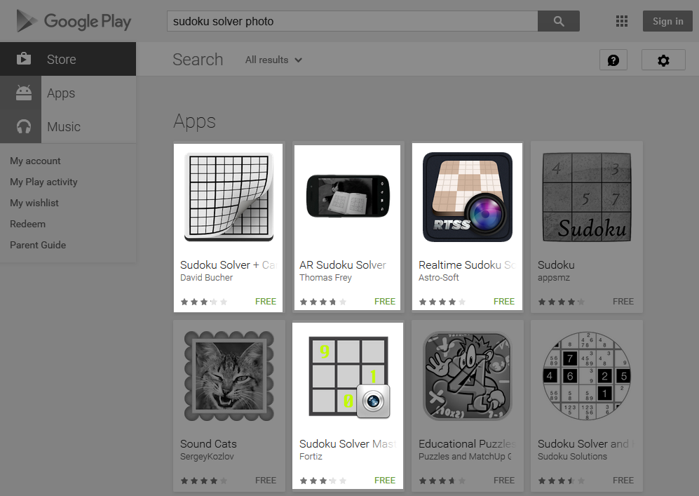
Motivacija
Bubble Cup 7 - round 1
Challenge problem - NP complete
http://www.spoj.com/problems/JCROSS/
C++ rešenje
Oko 2000 linija koda
Postoje slične aplikacije za rešavanje soudokua

Slide 4
Slična rešenja
An efficient algorithm for solving nonograms Chiung-Hsueh Yu, Hui-Lung Lee, Ling-Hwei Chen http://debut.cis.nctu.edu.tw/Publications/pdfs/J54.pdf
Object detection algorithms analysis and implementation for augmented reality system Rasa Zavistanavičiūtė, KAUNAS, 2012
Blob detection, Edge detection, Canny edge detector, Double thresholding, Sobel...
Printed and Handwritten Digits Recognition Using Neural Networks Daniel Cruces Álvarez, Fernando Martín Rodríguez, Xulio Fernández Hermida

Slide 5
Algoritam
Učitavanje slike
Detekcija cifri
Prepoznavanje cifri
Rešavanje
Prikaz rešenja
Detekcija linija
Ispravljanje perspektive
Pronalaženje nonograma

Slide 6
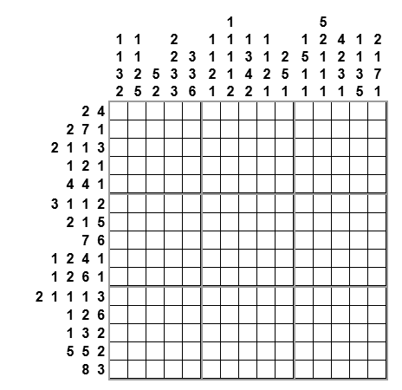
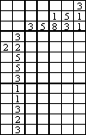
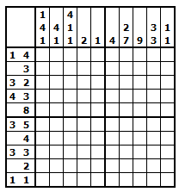
Pronalaženje nonograma
Binarizacija slike
Threshold
Canny edge detector
Image derivate
Random sample consensus (RANSAC)
Ramer–Douglas–Peucker algorithm

Slide 7
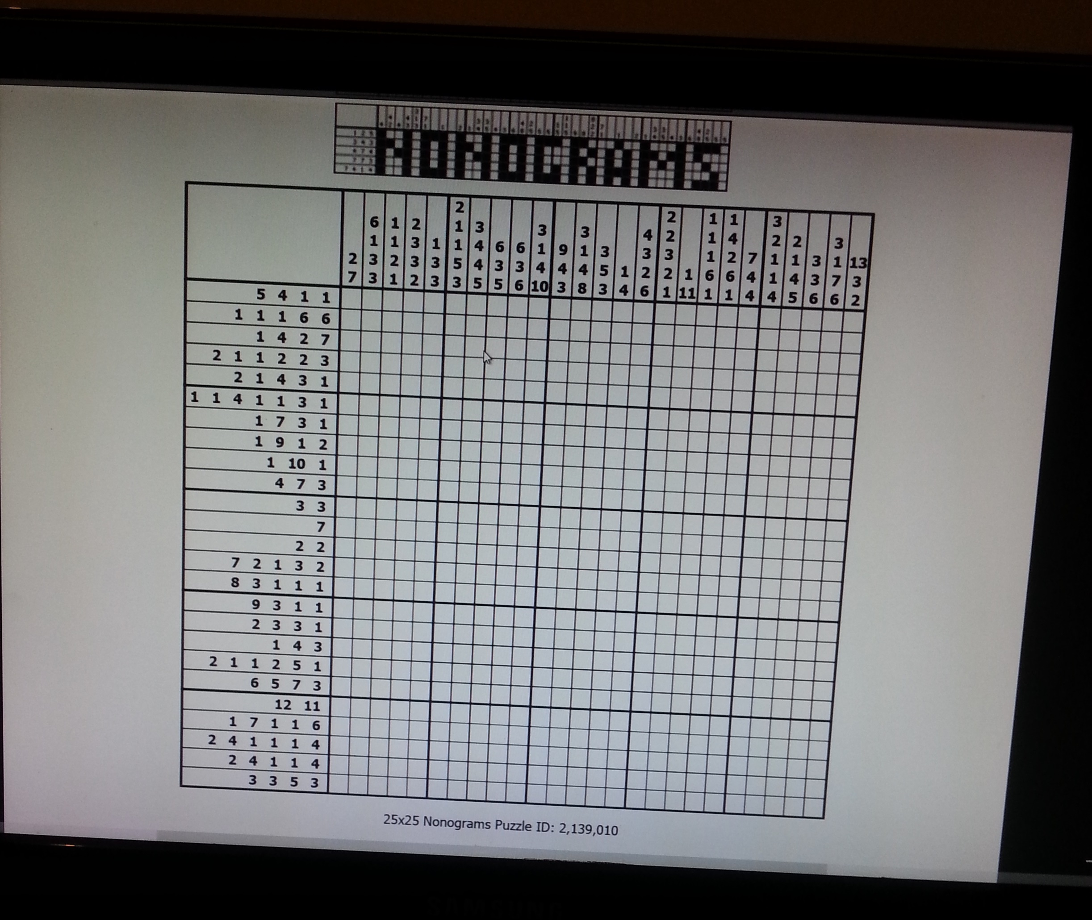
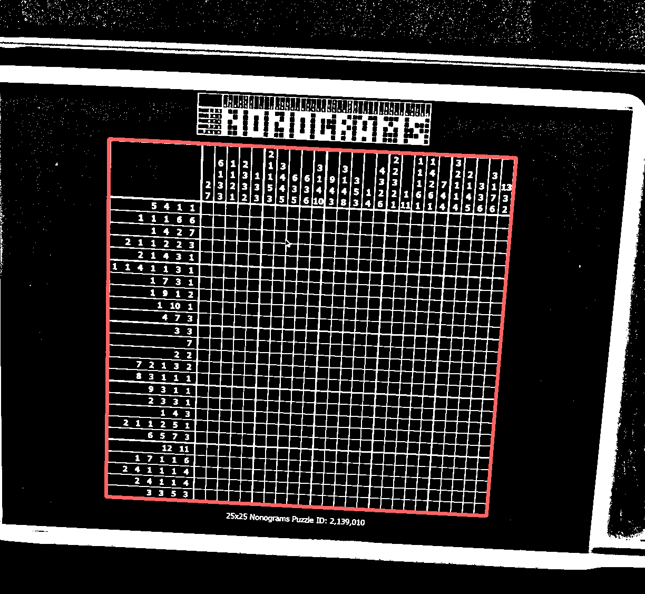
Pronalaženje nonograma
Originalna slika
Adaptive threshold + selection

Slide 8
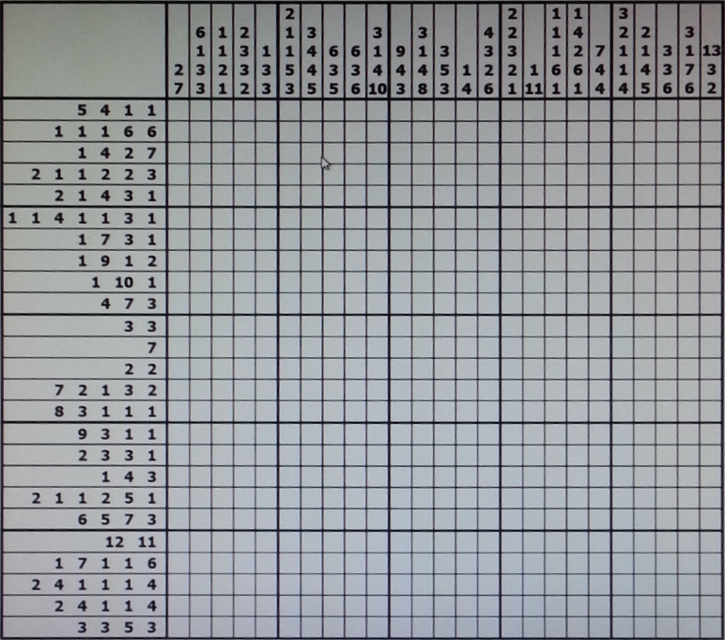
Ispravljanje perspektive

Slide 9
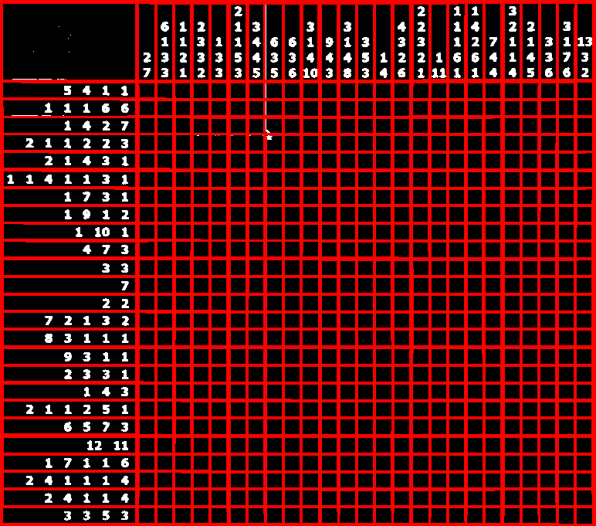
Detekcija linija
Standardna rešenja
Hough Line Transform
Probabilistic Hough Line Transform
Kerneli n x m, n >> m ili m >> n
Blur
Fixed Threshold

Slide 10

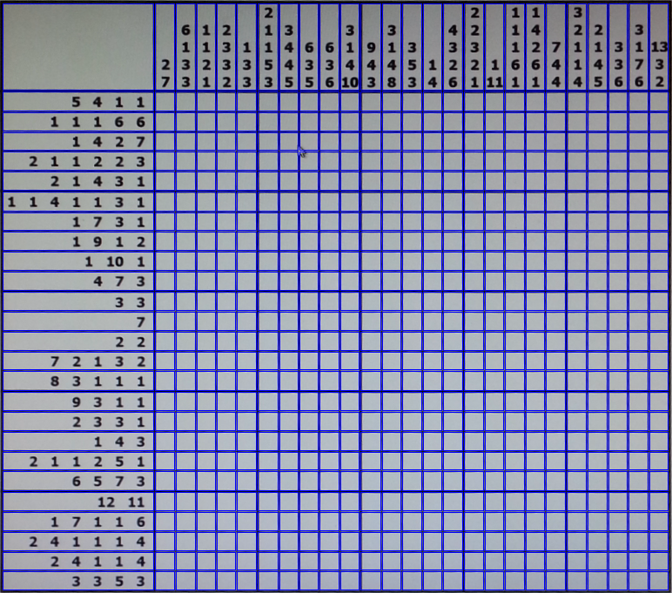
Detekcija linija
Kerneli n x m
Pravougaonici

Slide 11
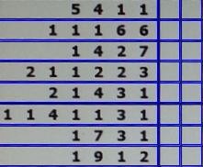
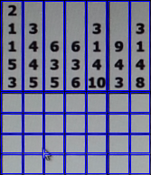
Detekcija cifri
Dve cifre ili dva broja?
k-means
DBSCAN
Dilate + contours

Slide 12
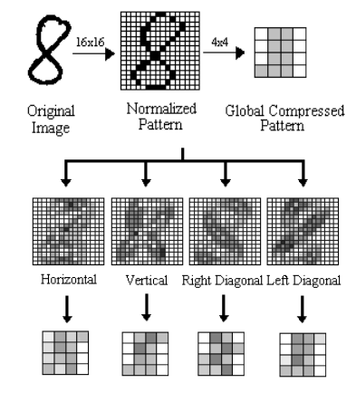
Prepoznavanje cifri
Data set
Neuronska mreža
Greška 1%

Slide 13


Rešavanje
Algoritmi
Simple boxing
Genetski algoritmi
Depth first search
Logička pravila

Slide 14
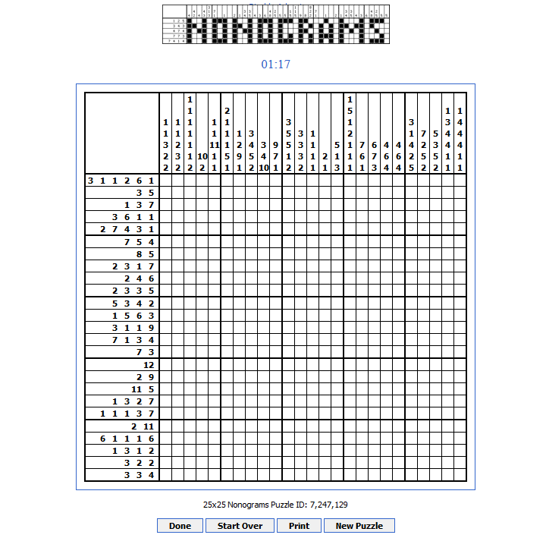
Verifikacija
http://www.puzzle-nonograms.com/
Do 20 x 20
Crno beli nonogrami

Slide 15
Hvala na pažnji
Srđan Milaković
srdjan.milakovic@outlook.com

